Slide 1
PORTFOLIO OPTIMIZATION USING MONTE CARLO SIMULATION
Ritesh Kumar
22112088

Slide 2
INTRODUCTION
Portfolio optimization is a critical task for investors aiming to maximize returns while managing risks. Traditional methods often use historical data and statistical techniques to construct optimal portfolios. Modern Portfolio Theory (MPT), a hypothesis put forth by Harry Markowitz in his paper “Portfolio Selection,” (published in 1952 by the Journal of Finance) is an investment theory based on the idea that risk-averse investors can construct portfolios to optimize or maximize expected return based on a given level of market risk, emphasizing that risk is an inherent part of higher reward. It is one of the most important and influential economic theories dealing with finance and investment.
Monte Carlo Simulation (MCS) has emerged as a powerful tool for portfolio optimization. MCS helps in simulating various market scenarios, allowing investors to make informed decisions. This report explores the application of Monte Carlo Simulation in portfolio optimization, analysing its benefits and limitations.

Slide 3
MONTE CARLO SIMULATION (MCS)
Monte Carlo simulation is a computational technique used to model and analyze complex systems and processes through random sampling. It is named after the famous casino city, Monte Carlo, because of the element of chance and randomness involved in the method.
KEY CONCEPTS OF MCS
Simulation Technique
Random Sampling
Probability Distribution
Modeling Complex Systems
Numerical Estimations

Slide 4
MONTE CARLO SIMULATION FOR OPTIMIZATION SEARCH
PROCEDURE:
Made four different portfolios with three stocks each and got their daily returns data from web.
Portfolios made are:
1. Amazon , Apple , Netflix
2. Google , Meta , Goldman Sachs
3. JP Morgan , Johnson & Johnson , Coco Cola
4. Microsoft , Accenture , Meta

Slide 5
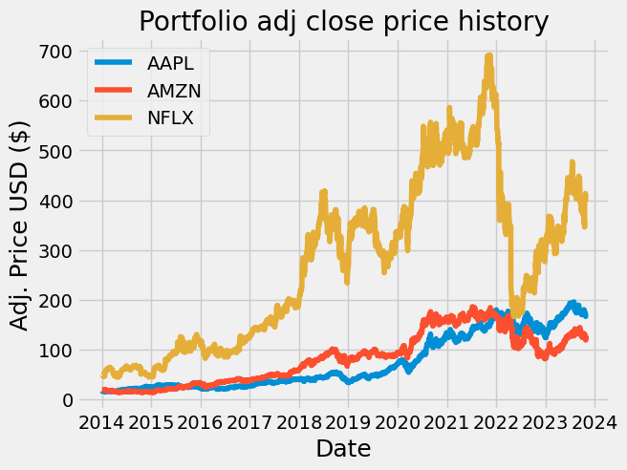
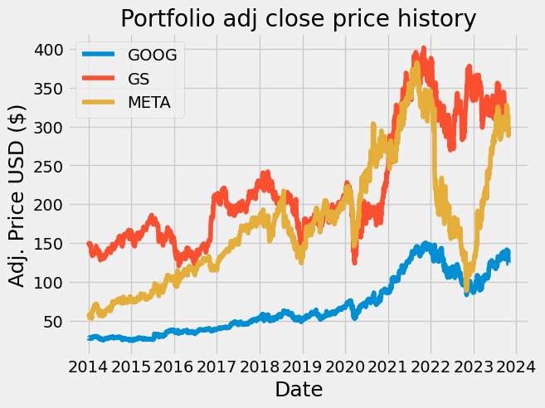
2. Calculated mean daily returns, percent change in stocks and correlation between them for
each portfolio
Mean daily returns:
1. AAPL 0.001081 AMZN 0.000972 NFLX 0.001231
2. GOOG 0.000760 GS 0.000430 META 0.000969
3. JNJ 0.000362 JPM 0.000598 KO 0.000314
4. ACN 0.000703 META 0.000969 MSFT 0.001099
3. Simulated thousands of possible allocations.
4. Plotted graphs for Portfolio Adj. Close Price History.

Slide 6
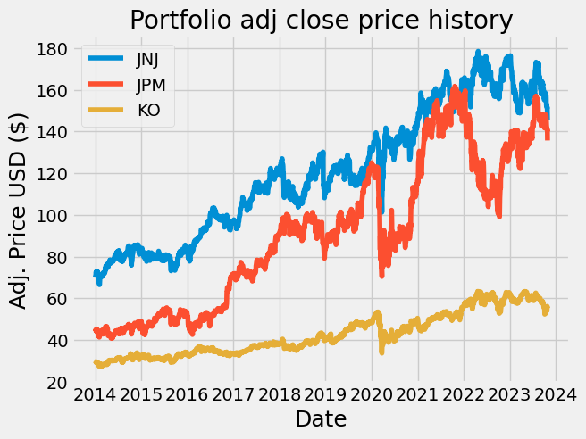
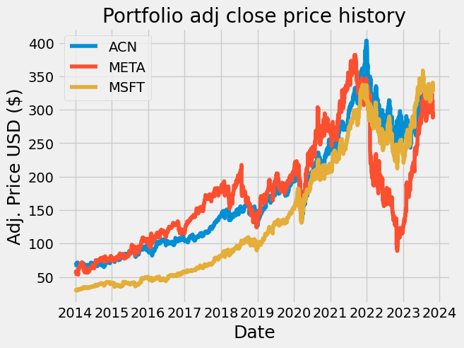
We will now switch over to using log returns instead of arithmetic returns. Most technical analyses require detrending/normalizing the time series and using log returns is a nice way to do that.
Computed log returns, its mean, pairwise covariance of columns and multiplied it by number of days

Slide 7
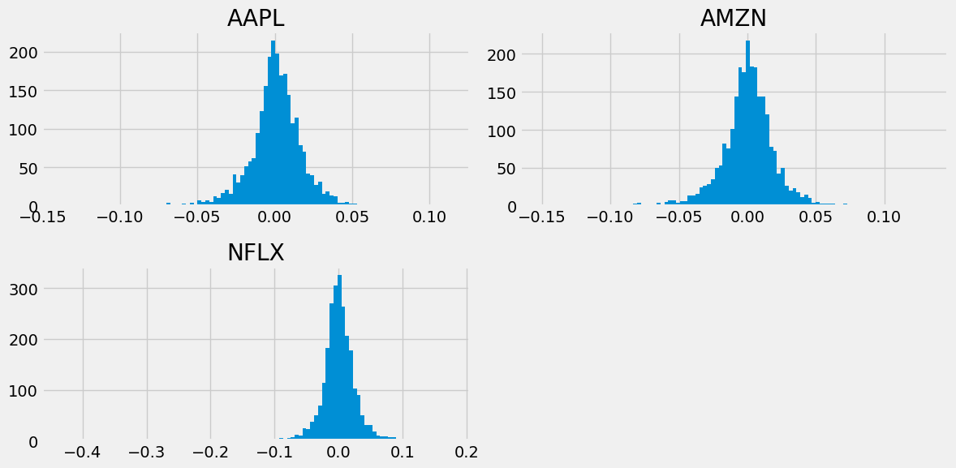
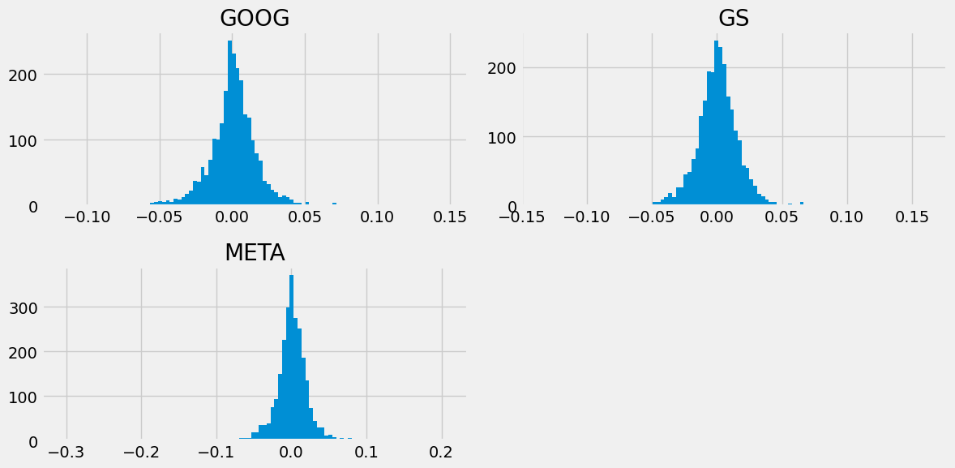
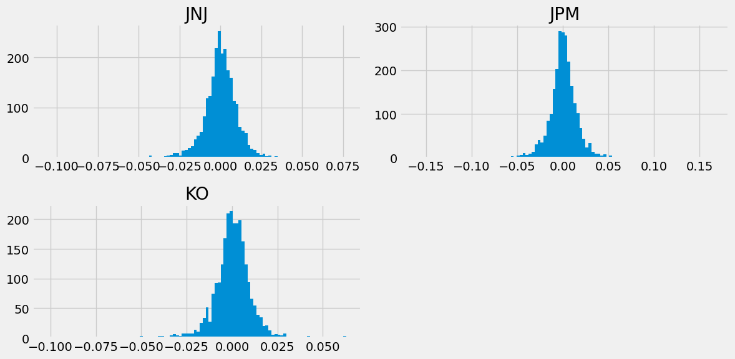
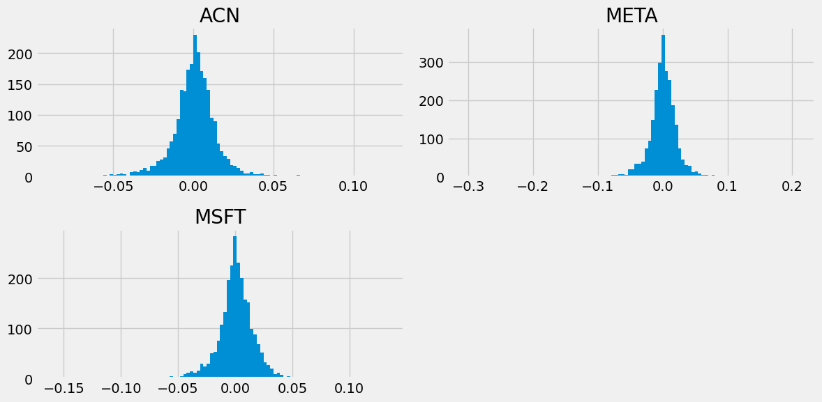

Slide 8
Mean log returns:
AAPL ; 0.231629 AMZN : 0.189546 NFLX : 0.207770
GOOG : 0.152212 GS : 0.68556 META : 0.172361
JNJ : 0.074813 JPM : 0.114069 KO : 0.062789
ACN : 0.147677 META : 0.172361 MSFT : 0.239886
6. We then ran it for some random allocation and then again did it many times.
7. Created random weights, rebalanced and saved them.
8. Calculated expected return, expected volatility and Sharpe ratio
Expected Portfolio return:
1. 0.209491650398994170
2. 0.10993143233757413
3. 0.0945764070741771
4. 0.1626577032673327
Expected Volatility
1. 0.2725684960762145
2. 0.24145310264261208
3. 0.19187411176677283
4. 0.2723362768863687
Sharpe ratio
1. 0.768583506218624
2. 0.455291032231172
3. 0.492967184767432
4. 0.597267852549813

Slide 9
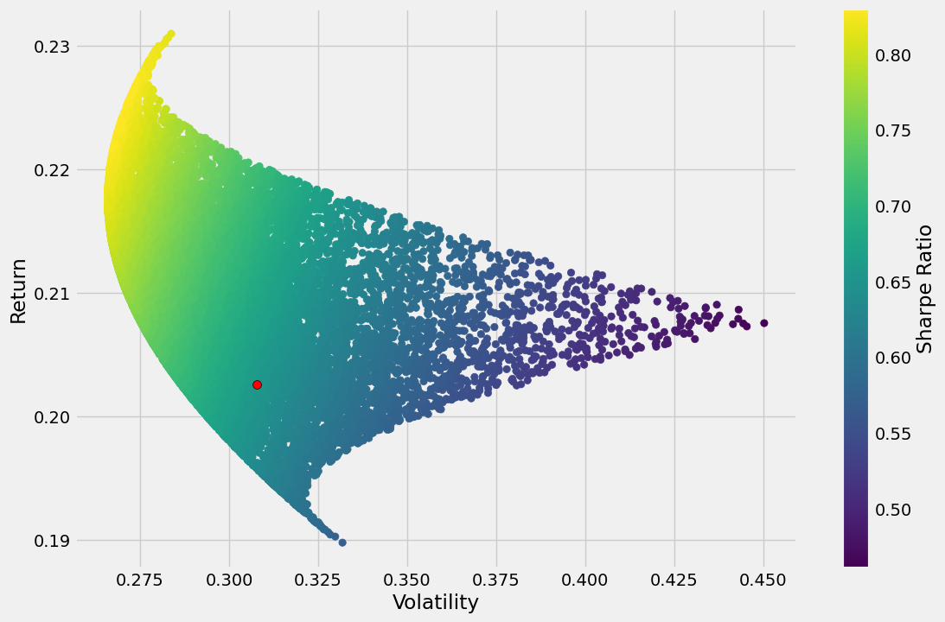
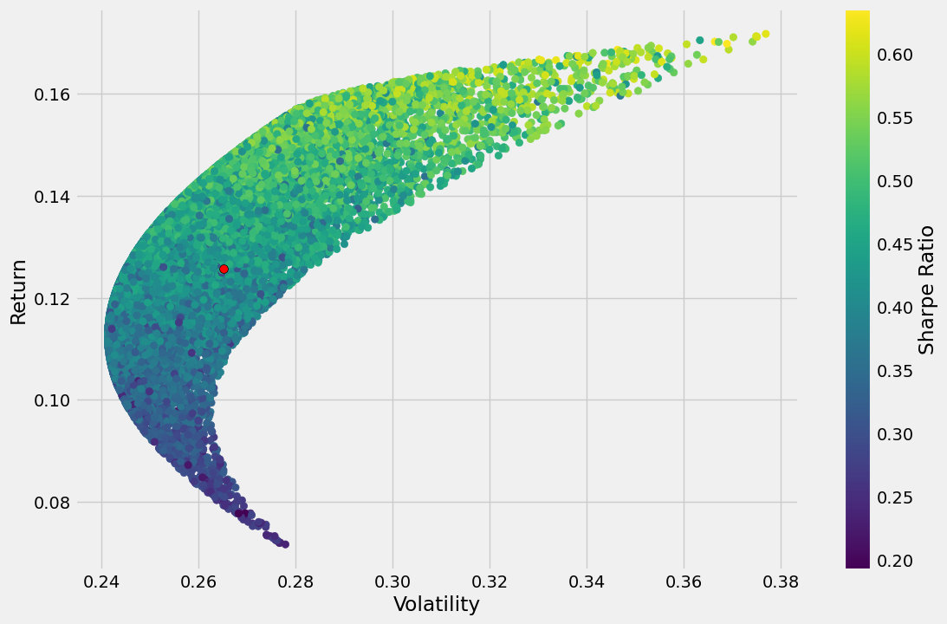
1. Plotted the graph between returns and volatility.

Slide 10
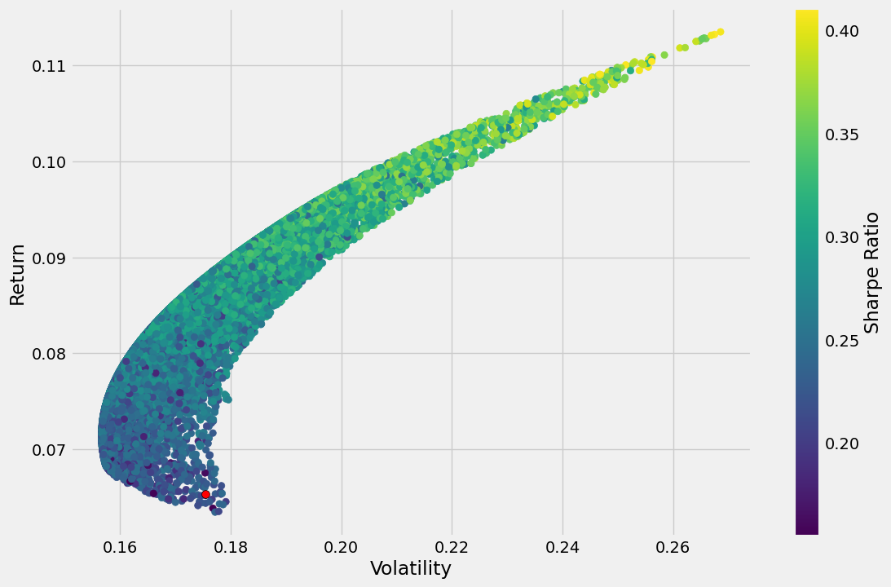
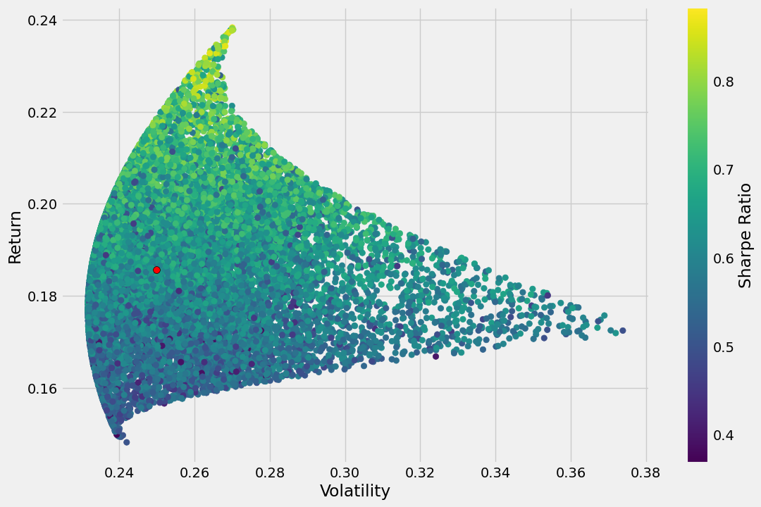

Slide 11
There are much better ways to find good allocation weights than just guess and check! We can use optimization functions to find the ideal weights mathematically!
Optimization works as a minimization function, since we actually want to maximize the Sharpe Ratio, we will need to turn it negative so we can minimize the negative Sharpe (same as maximizing the positive Sharpe)
2. Calculated the optimal results using SLSQP method of minimize function.
3. Made all optimal portfolios (Efficient Frontier) and plotted the graph between return and volatility.
The efficient frontier is the set of optimal portfolios that offers the highest expected return for a defined level of risk or the lowest risk for a given level of expected return. Portfolios that lie below the efficient frontier are sub-optimal, because they do not provide enough return for the level of risk. Portfolios that cluster to the right of the efficient frontier are also sub-optimal, because they have a higher level of risk f for the defined rate of return

Slide 12
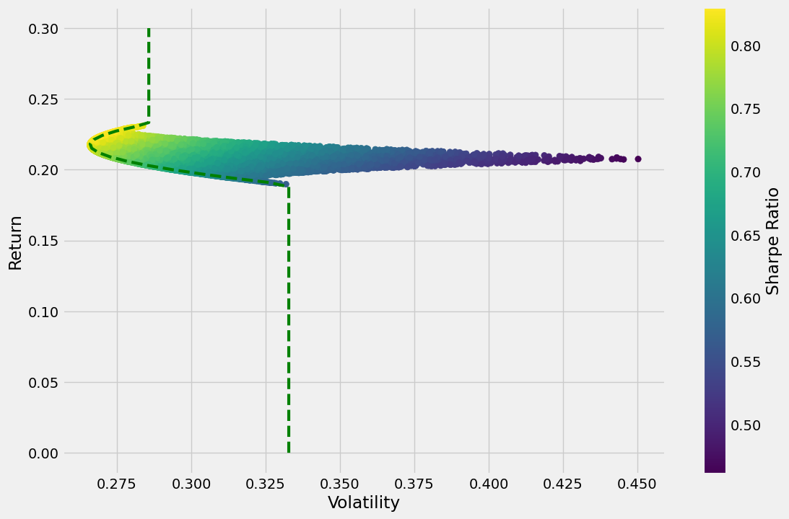
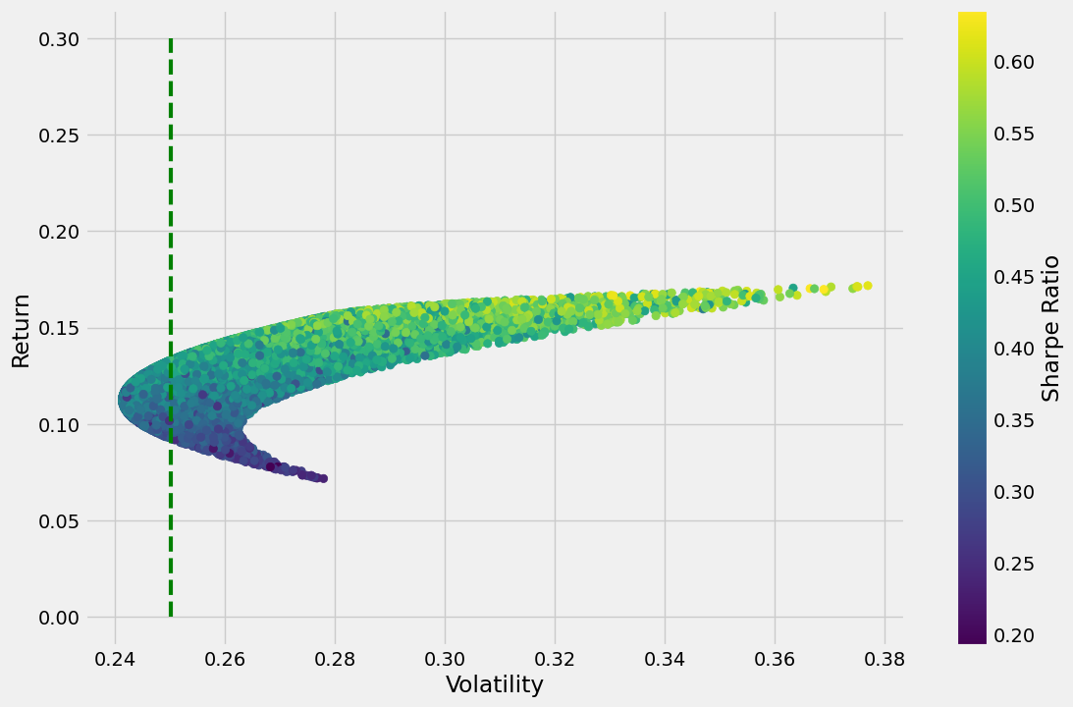

Slide 13
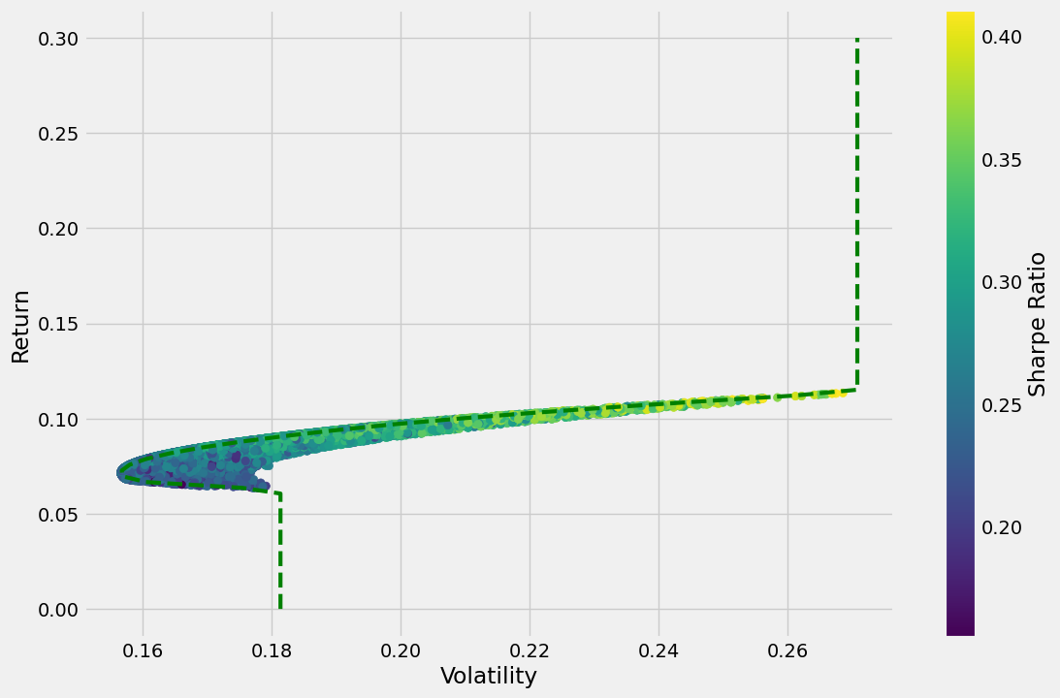
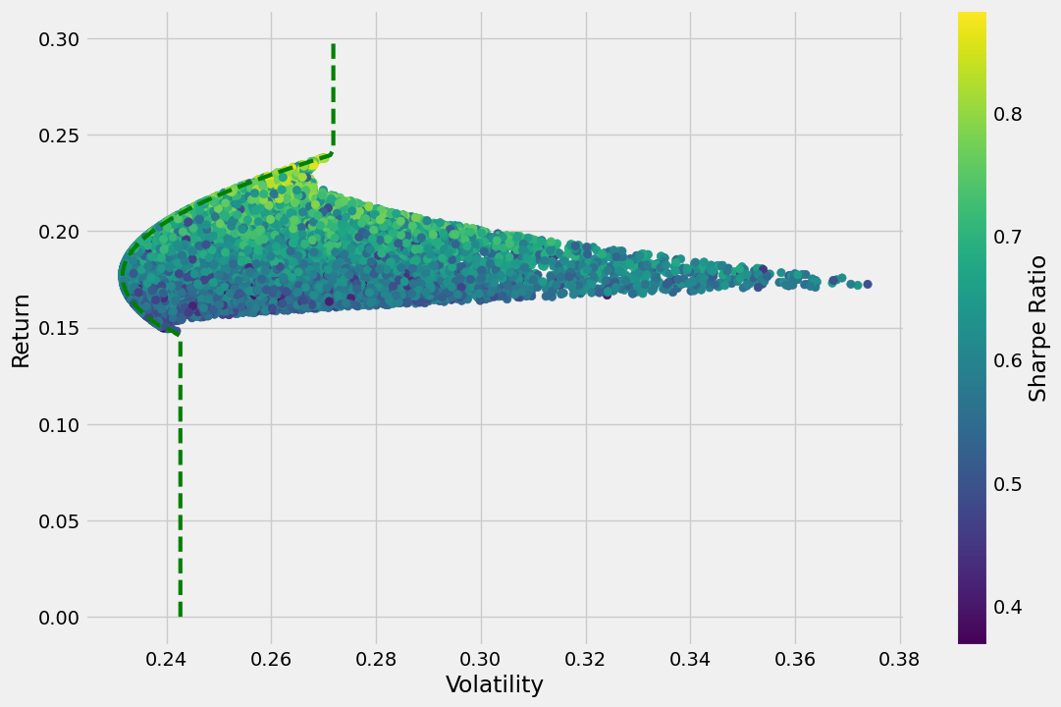

Slide 14
Conclusion:
Monte Carlo Simulation provides a powerful framework for portfolio optimization, enabling investors to make more informed decisions in the face of uncertainty. By simulating a wide range of market scenarios, investors can gain insights into the potential risks and rewards associated with different investment strategies. However, it is crucial to recognize the limitations and challenges associated with MCS and to use it in conjunction with other analytical tools and qualitative judgment for robust portfolio construction. As financial markets continue to evolve, the application of Monte Carlo Simulation is expected to play an increasingly important role in the field of portfolio management.

Slide 15


THANK YOU
RITESH KUMAR
22112088
2ND YEAR B.TECH. CHEMICAL
ENGINEERING
ritesh_k@ch.iitr.ac.in

